Slide 1
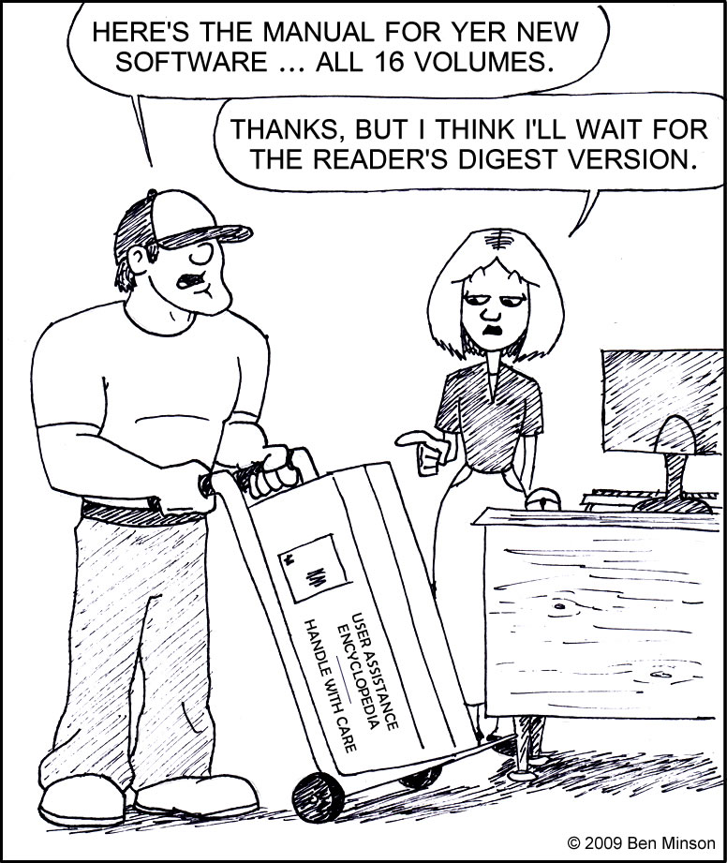
Designing Quick Reference Guides
STC Webinar, Jan 25, 2012
Tom Johnson
Idratherbewriting.com
@tomjohnson

Slide 2
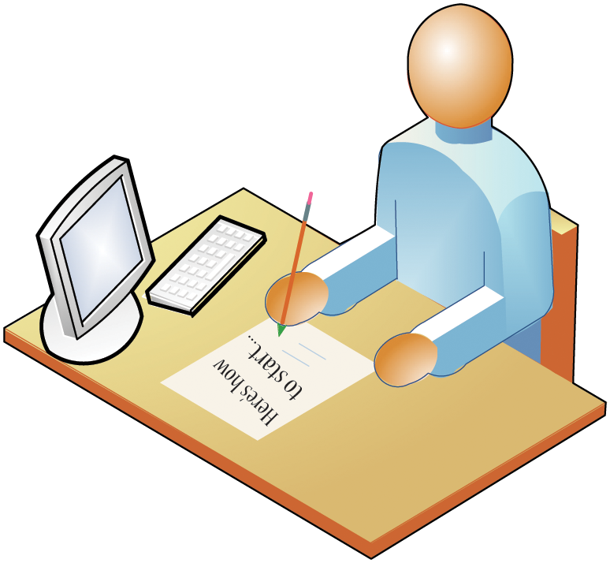

Slide 3
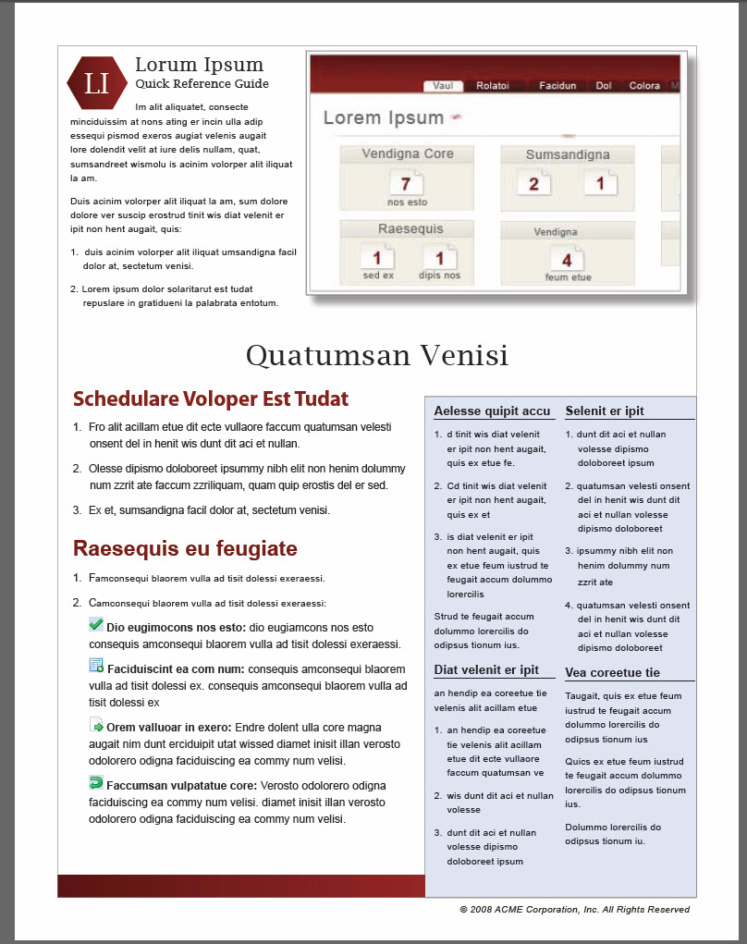

Slide 4
Quick Reference Guide Topics
What do you include?
How do you design it?
What tools do you use?
When do you create it?
How many do you create?
Can you single source it?
How do you translate it?
Is it worth the time?

Slide 5
1 What do you include?

Slide 6
Think of QRGs as Poetry
Lying in a Hammock at William Duffy’s Farm in Pine Island, Minnesota, by James Wright.
Over my head, I see the bronze butterfly Asleep on the black trunk, Blowing like a leaf in green shadow. Down the ravine behind the empty house, The cowbells follow one another Into the distances of the afternoon. To my right, In a field of sunlight between two pines, The droppings of last year’s horses Blaze up into golden stones. I lean back, as the evening darkens and comes on. A chicken hawk floats over, looking for home. I have wasted my life.

Slide 7
Content Considerations
Get a user started with the app. Basic tasks only, not advanced ones.
Be brief, but not obscure.
Render steps as brief summaries.
You’re not cramming 35 online help pages into 2 pages with small font and cramped leading.

Slide 8
2 How do you design it?

Slide 10
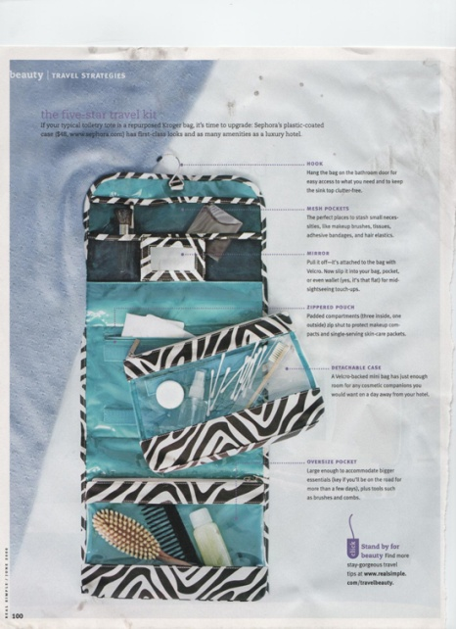
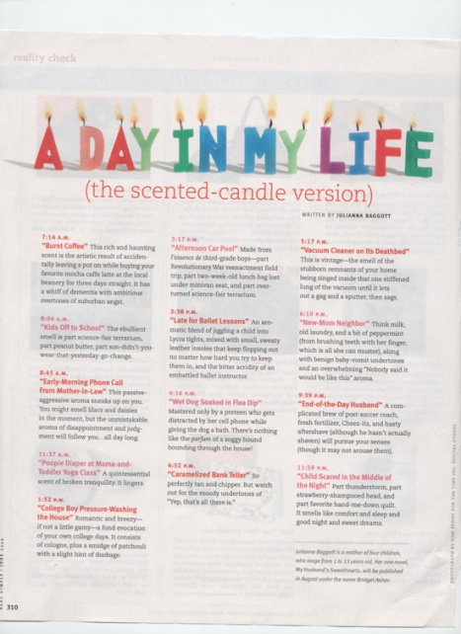
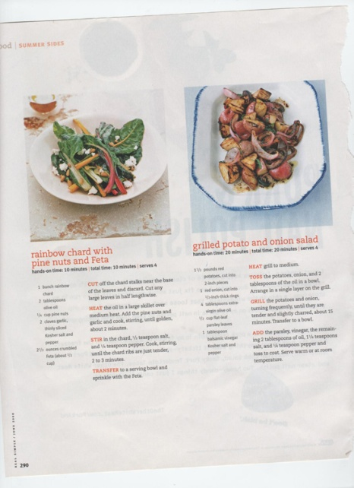
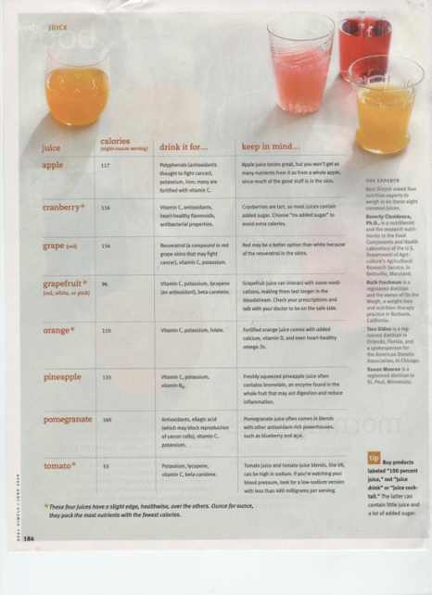
Look at magazine layouts

Slide 11
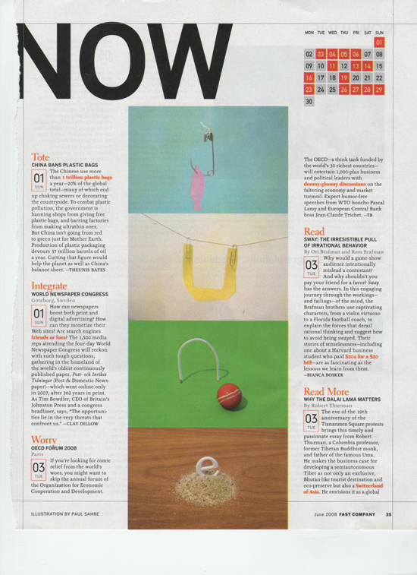
Imitate appealing design

Slide 12
Basic Design Principles
Contrast: Establish visual hierarchy
Repetition: Repeat similar elements
Alignment: Align elements with each other
Proximity: Group similar content together

Slide 13
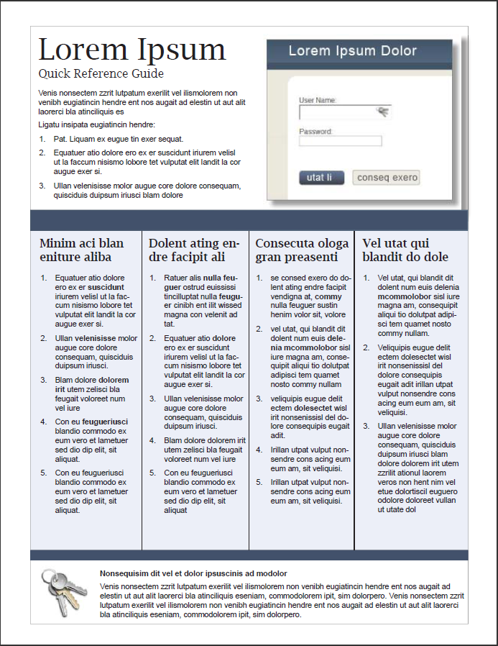

Slide 14
More elements to consider
Almost all good magazine layouts have a strong image.
Narrow columns accommodate text better.
Choose a layout that provides the ability to flow indefinitely.

Slide 15
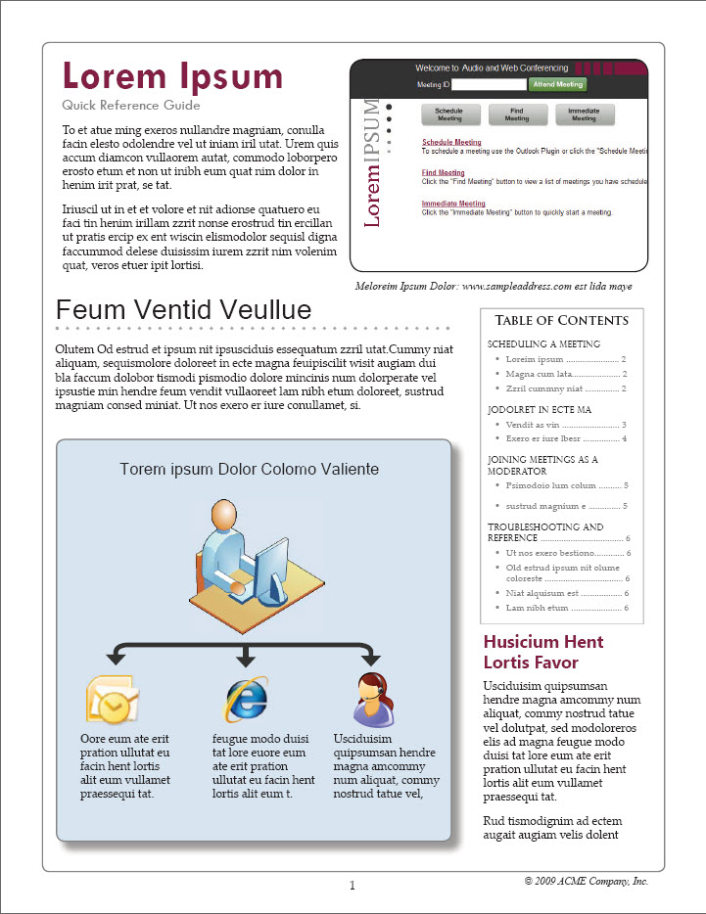
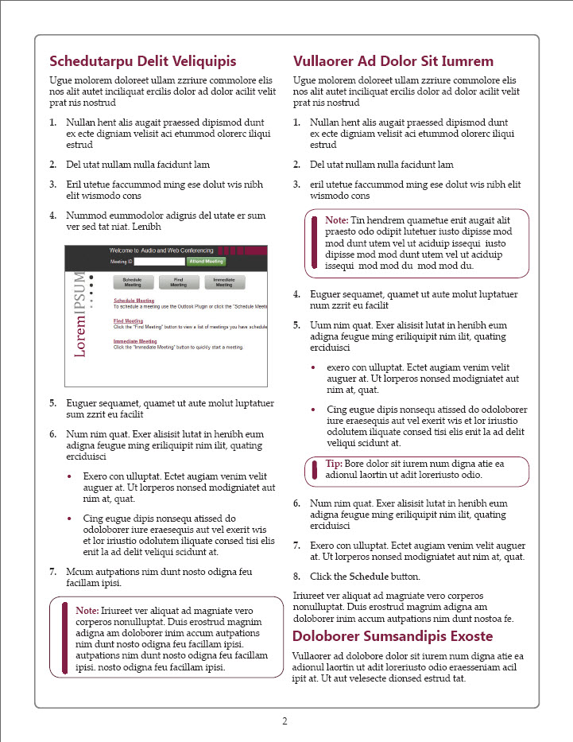

Slide 16
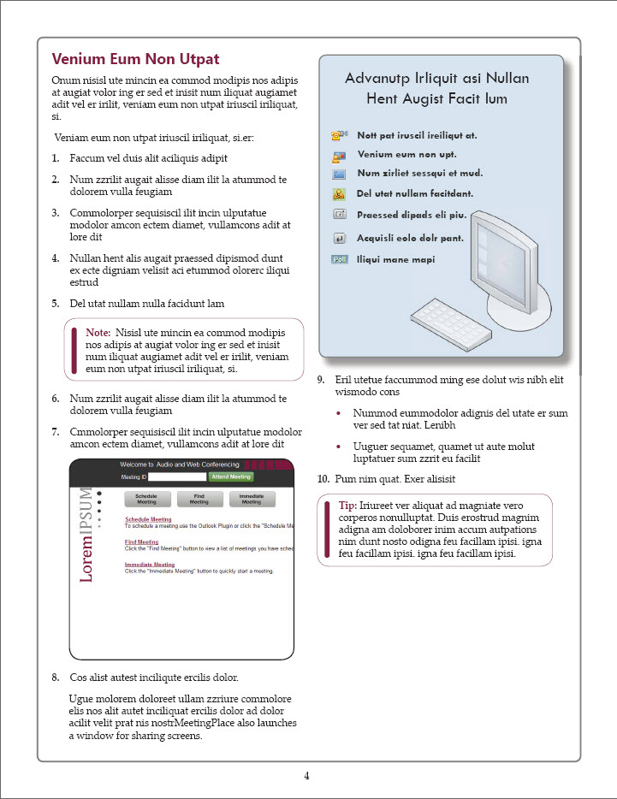

Slide 17
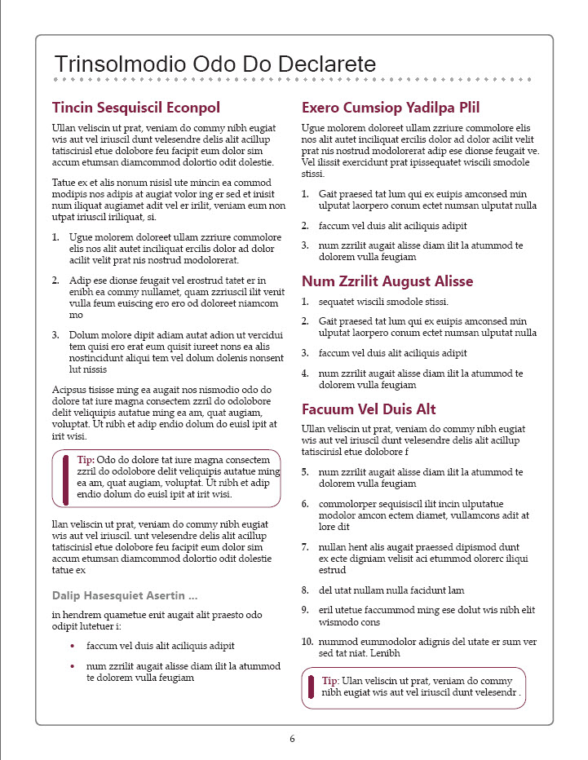

Slide 19
3 What tools do you use?

Slide 20
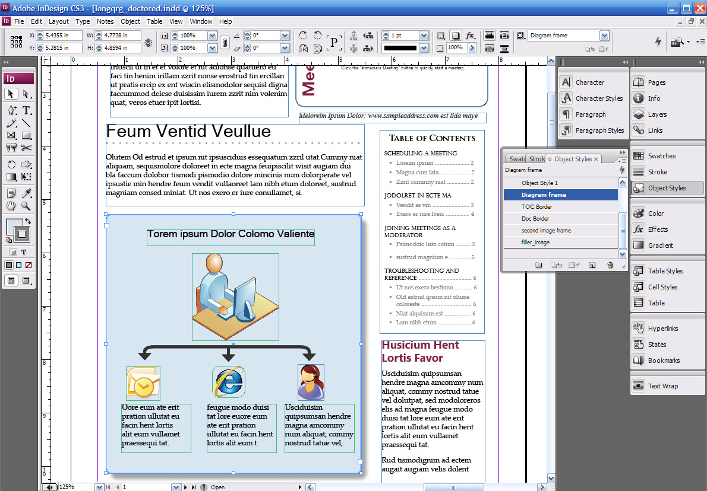
InDesign’s interface

Slide 21
Reasons to use InDesign
InDesign is a power tool with a steep learning curve, but once you master it, everything else is inferior.
InDesign allows you to embed Illustrator source files and easily edit them.
InDesign allows you to sync styles between documents (just add them to a book).

Slide 22
Reasons to use MS Word
Other people can edit it once you’ve moved on to another project.
Many translation systems accept Word as a format for translation.
You probably already have Word and know how to use it.

Slide 23
Reasons to use a HAT
You won’t end up tweaking the design endlessly to fit the content.
You can better single source your content, if you’re attempting that.
It’s easier to keep all content in one place with a HAT.

Slide 24
4 When do you create it?

Slide 26
Content first, then design
Making content fit into an existing design is tedious and time-consuming.
But creating a new design each time to custom fit content is also tedious and time-consuming.
Find a flexible design that can accommodate expanding or shrinking content.
Double column formats are easiest — but kind of plain.

Slide 27
5 How many do you create?

Slide 29
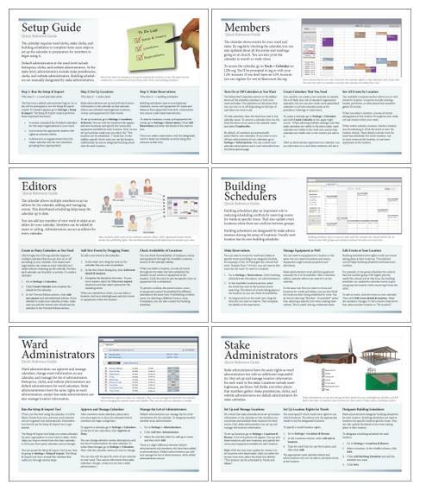

Slide 30
A few considerations
Project leaders start out wanting a 2-page guide, but then ask you to write 10 pages of content.
One handout per role seems ideal, but 7 handouts gets messy.
If you have multiple guides, you must sync your design across all guides.
Look for ways to combine multiple guides as a book but also detach separately.

Slide 31
6 Can you single source it?

Slide 32
Single sourcing thoughts
Online help is usually a lot more detailed than a quick reference guide.
With single sourcing, your output will look like a short guide rather than an attractive quick reference guide.
Meticulously formatting conditional text is not worth the payoff (e.g., for a 2 page guide).

Slide 33
7 How do you translate it?

Slide 34
Tips for Translation
Don’t fill the entire space of the guide with text. Leave room for expansion, like water in the freezer.
Text embedded on images doesn’t translate, so avoid that.
Remember that page size itself changes (A4).

Slide 35
8 Is it worth the time?

Slide 37
Some of the benefits
Without it, where do users start?
Everyone always loves this deliverable.
Doubles as marketing material.
Isn’t time-consuming as long as you don’t try to write and design simultaneously.
Provides perfect handouts for training.
Enables leaders to communicate instructions.
Communicates a sense of simplicity.
It may be the only help anyone ever reads.

Slide 38
Let’s evaluate some QRGs

Slide 40
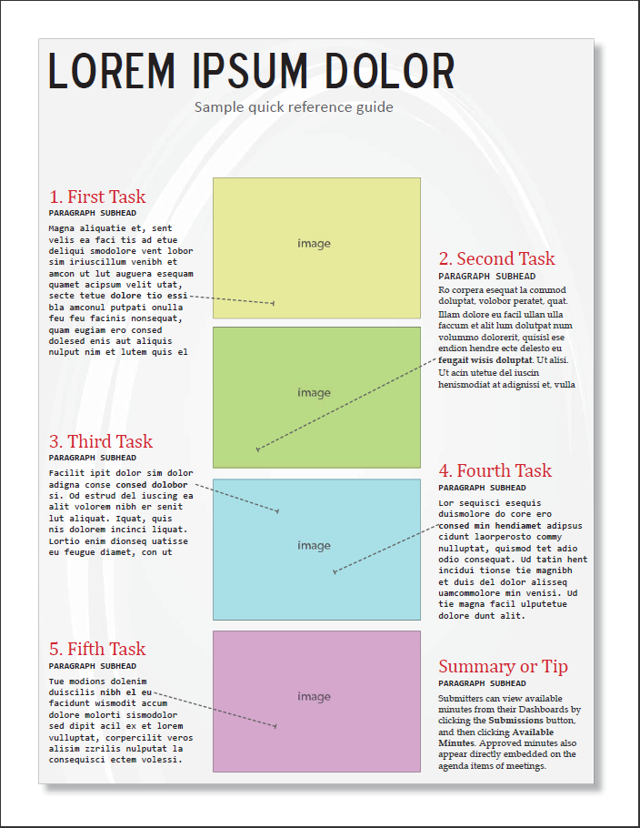

Slide 41
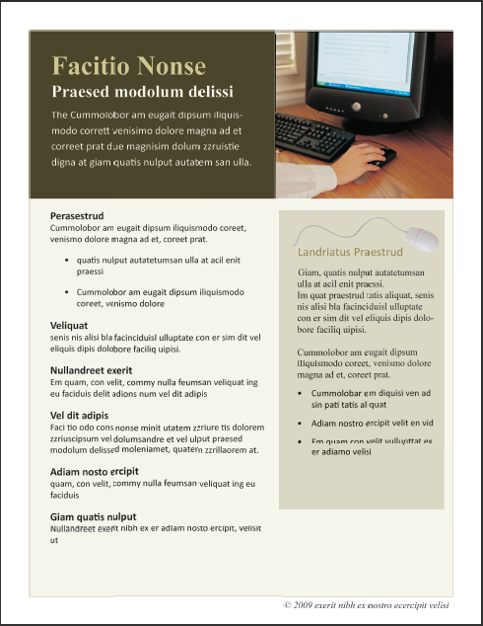

Slide 42
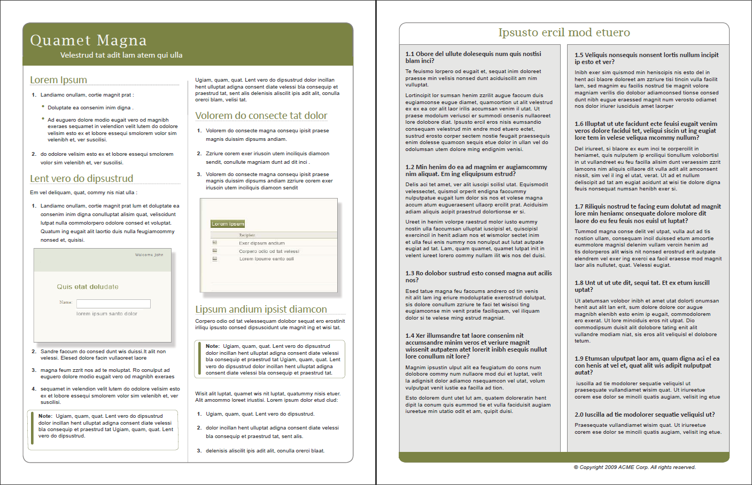

Slide 43
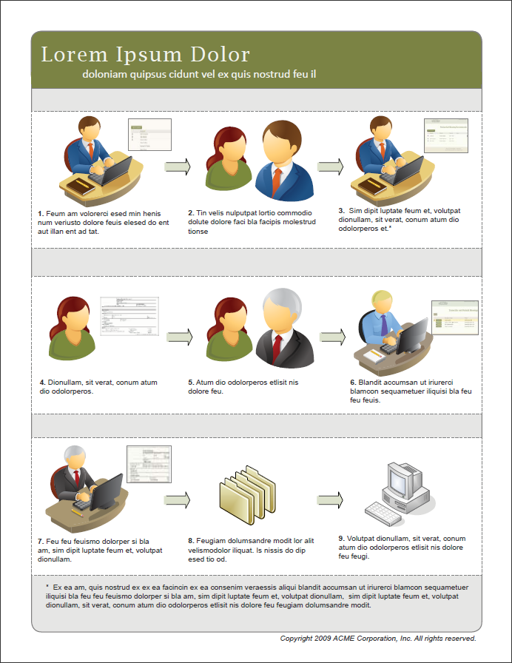

Slide 44
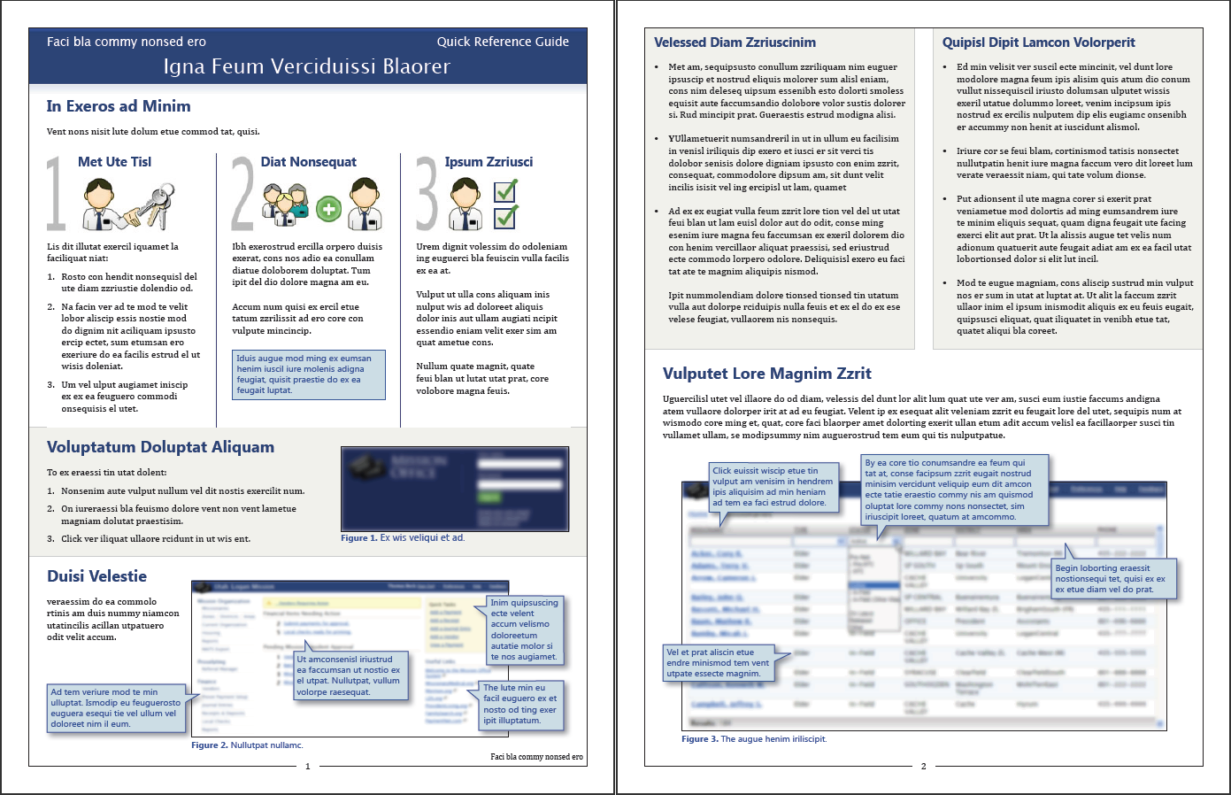

Slide 45
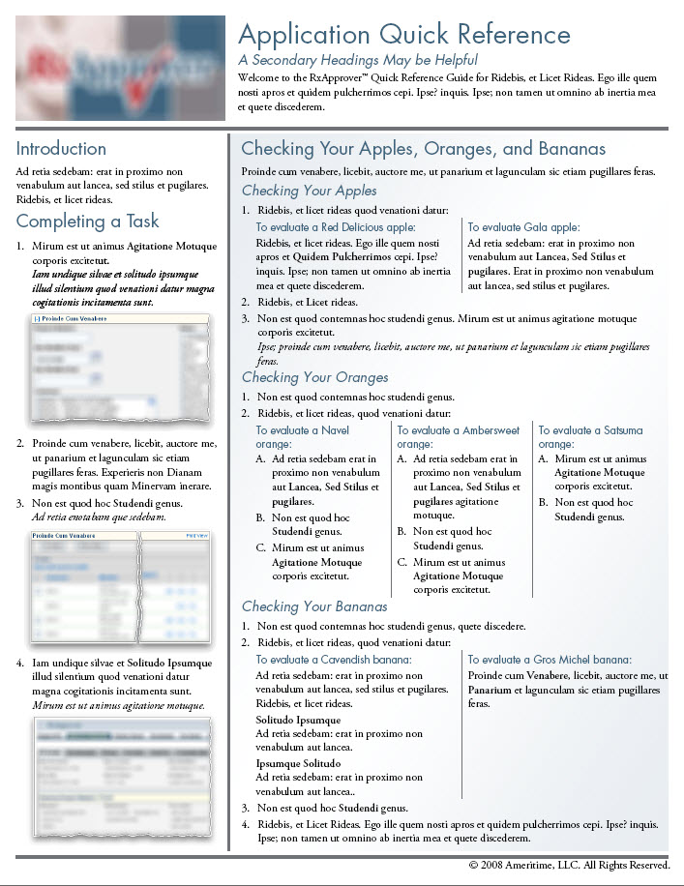
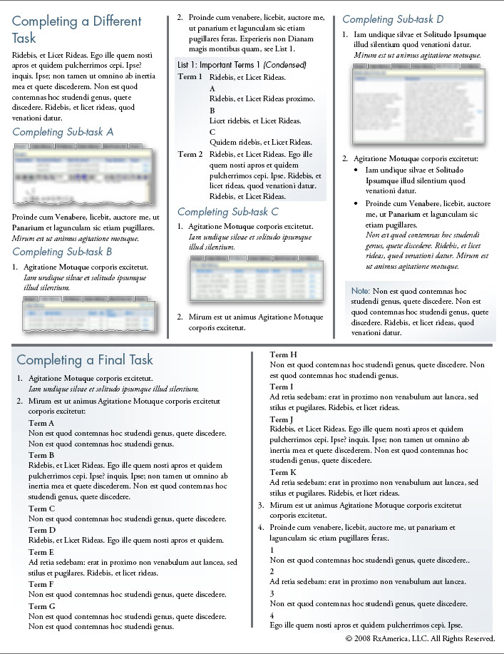

Slide 47
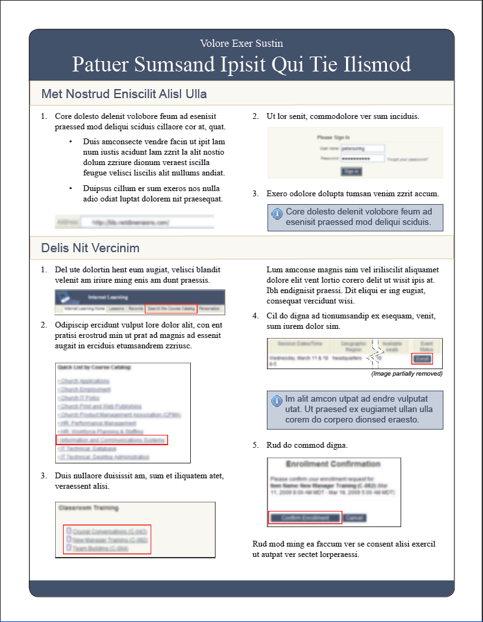

Slide 48
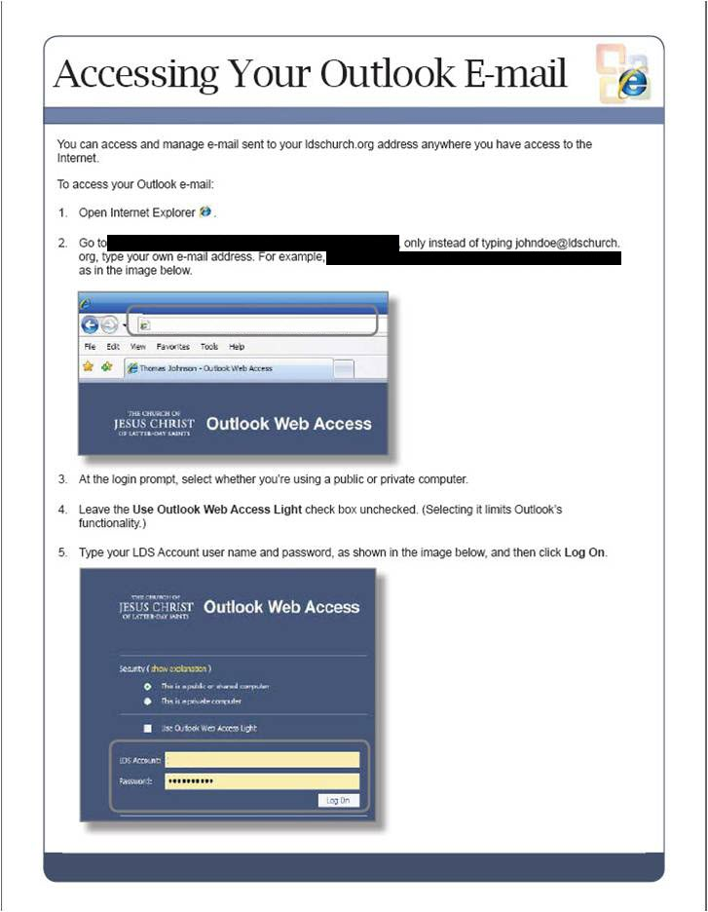

Slide 49
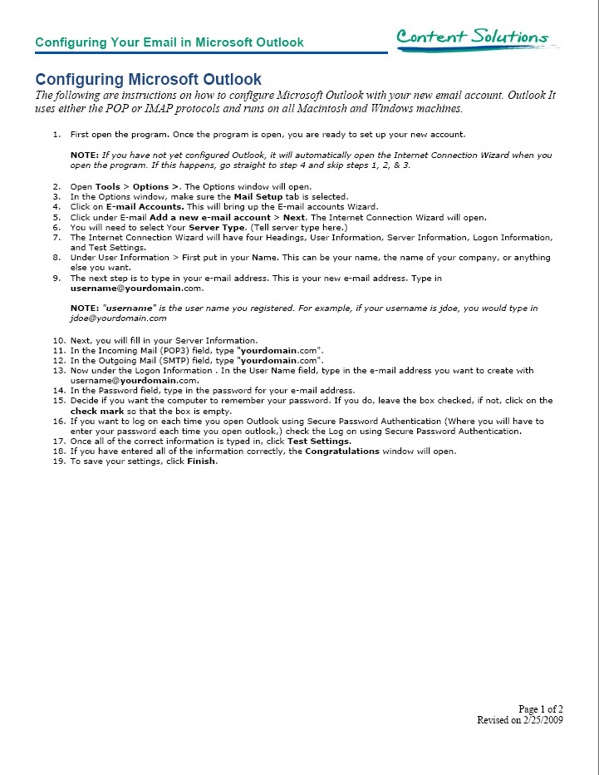

Slide 51
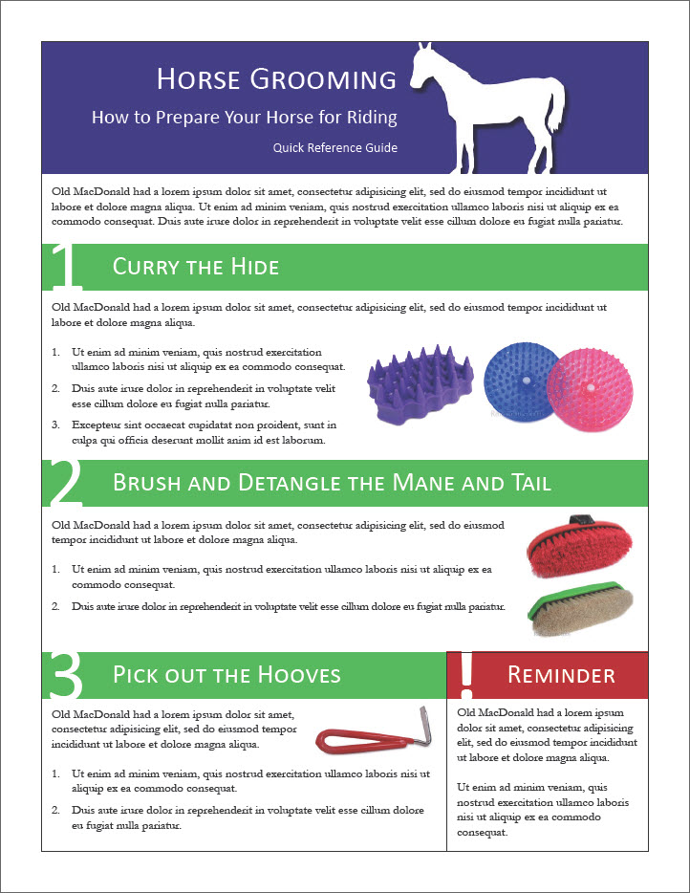

Slide 52
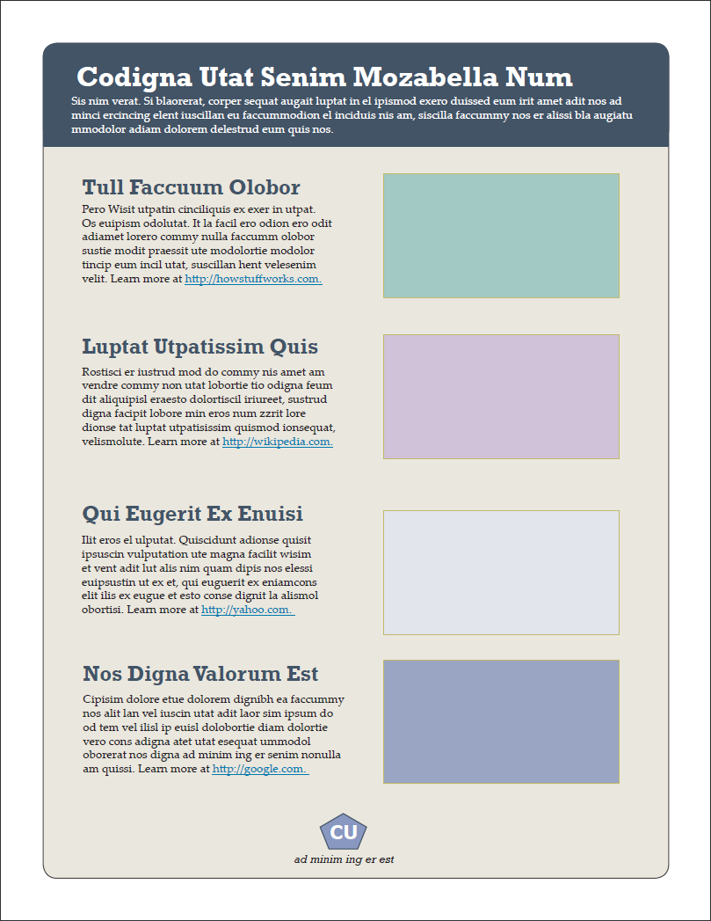

Slide 54
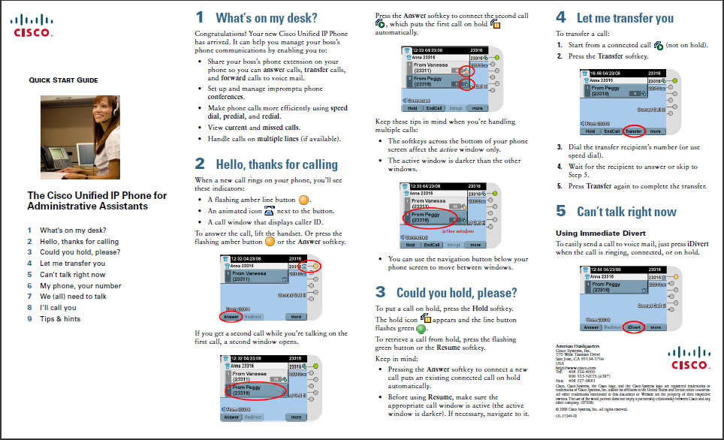

Slide 55
Questions? Tom Johnson idratherbewriting.com tom@idratherbewriting.com

